Slide 1
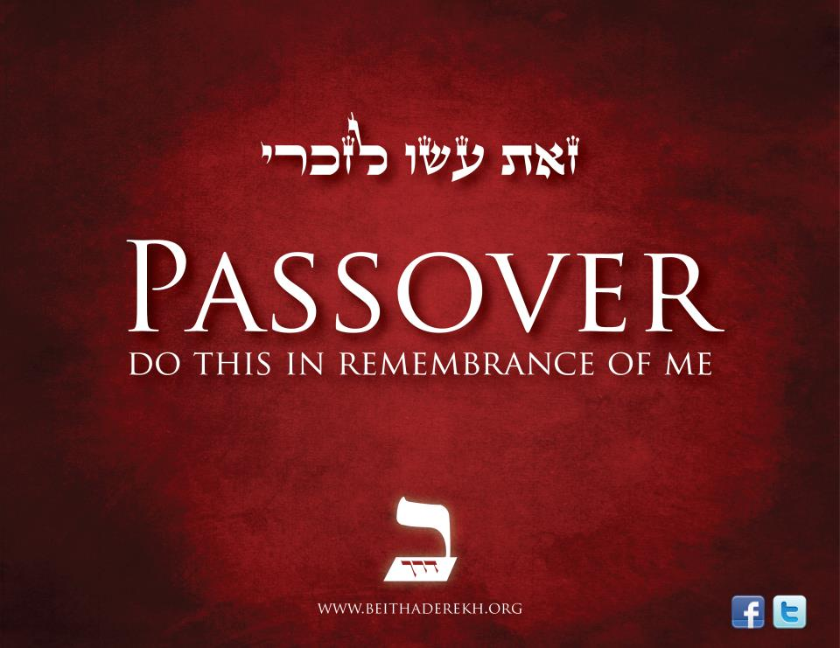

Slide 2

“In that night they were redeemed, and in that night they will be redeemed.”

Slide 3
On the Last Supper Night, the 3 Disciples slept. Jesus prayed in the Garden, but why did they sleep?

Slide 4
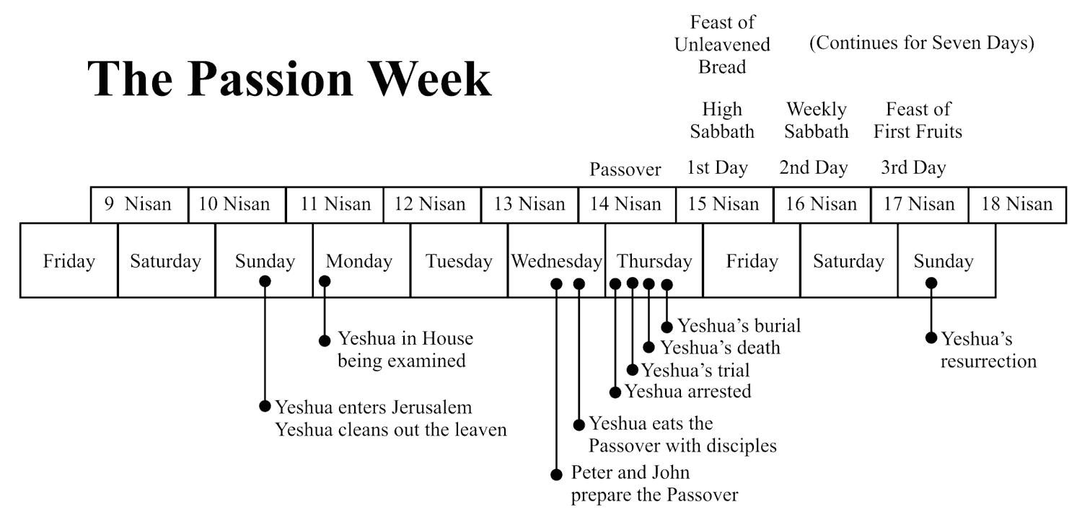

Slide 5
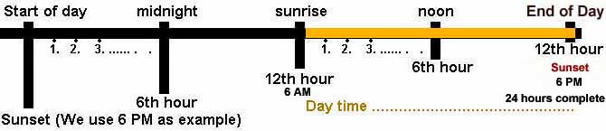

Slide 6
PREPARATIONS
The first Passover (Exodus 12)
First century Passover Feast, required everyone to travel to Jerusalem.
Huge meals, with 4 cups of wine.
Many days of travel, then many days of meal preparations, to end with a late evening of eating.

Slide 7
PASSOVER
Remembrance of the First Passover, by readings, songs, dinner, and prayer.
Jesus observed His feast with His Disciples in the Upper Room, and then took them to the Garden.
Where were all the other Disciples who cheered Him into town?
Messianic prophecies were read and thought to occur during the Passover.

Slide 8
UNLEAVENED
The Passover began on the same day as the Feast of Unleavened Bread.
This gives us an understanding of the type of Bread Jesus used to institute the Lord’s Supper.
All leaven was put away during this week, Leaven represent evil, infection, and fermentation.
Jewish Scholar David Daube’s belief of the piece that was separated.

Slide 9
FEAST OF FIRST FRUITS
Three days later.
Celebrates the Harvest of the spring time.
Read Ezekiel 37:5 , the valley of the dry bones being raised.
Messianic of the dead (Christ) being raised.
1 Corinthians 15:20-23

Slide 11
CLOSING
The Night in the Garden, the Disciples slept because of the huge meals.
Jesus was taken and tried in the night, and crucified in the morning, while every one slept.
Jesus was the Passover Lamb that was sacrificed for our sins, the Unleavened Bread that sustains us, and the First Fruit from the Dead,
“Of his own will he brought us fourth by the word of truth, that we should be a kind of firstfruits of his creation.

Slide 12
